Slide 1

Leeson 3, 4: Supervised Machine Learning: Regression, Classification and Model Evaluation

Slide 2
Learning objectives
Distinguish regression from classification and identify appropriate climate applications.
Explain how linear regression and logistic regression make predictions.
Train a basic supervised learning model using Python and scikit-learn.
Evaluate regression predictions using MAE and RMSE.
Evaluate classification predictions using a confusion matrix, precision, recall and accuracy.
Explain why baselines, chronological testing and data leakage prevention are essential for climate forecasting.

Slide 3
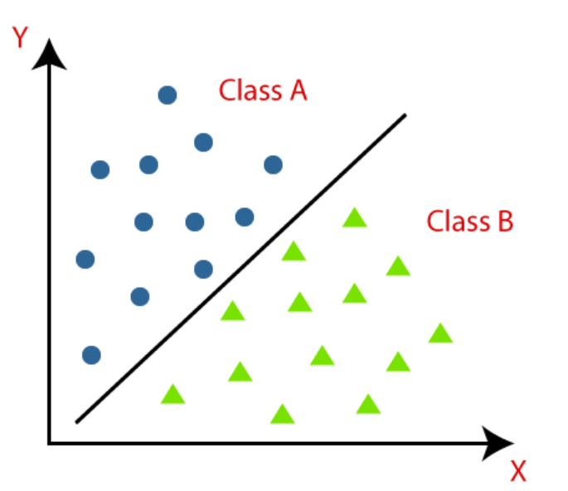
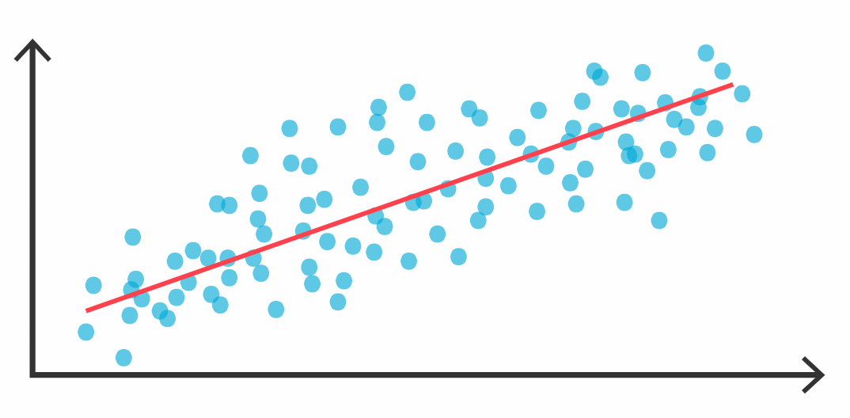
Recap
Supervised Learning
Regression
Classification
Notes:
In last session, We talked about supervised learning. In supervised learning The algorithm learns to map input data to corresponding output labels. We have some datas and labels and we are giving them together to model and we are expecting to learn the algorithm this relation. Then predict tp new unseen data correctly. We talk about the difference between regression and classification. In regression we have continuous outputs. We gave an example house size and price. Did you remember. In classification we have dicreate labels. Like cats, dog.

Slide 4
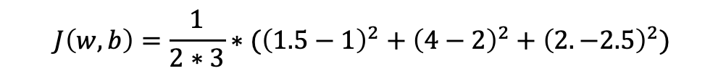
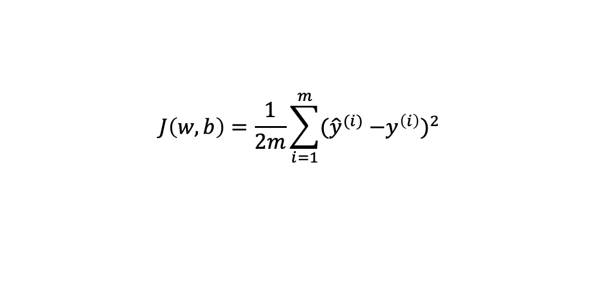
$$f_{\overline{w},b}\left(\overline{x}\right)=wx+b$$
y
$$J\left(w,b\right)=\frac{1}{2m}\sum_{i=1}^{m}{({\hat{y}}^{(i)}}{−y^{\left(i\right)})}^{2}$$
x
f(x) = 0.5*x + 1
4
2
1
$$J\left(w,b\right)=\frac{1}{2∗3}∗({\left(1.5−1\right)}^{2}+{\left(4−2\right)}^{2}+{\left(2. −2.5\right)}^{2})$$
1
3
2
Notes:
In here we have regression example and we want to learn how put boundary and we want to calculate the error. Using mean suared error we can calculate the error. If we look the equation ….

Slide 5
$$J(w)$$
$$positive slope$$
$$w$$
$w_{j}=w_{j} −∝\frac{∂}{∂w_{j}}$ $J\left(\overline{w},b\right)$
$$J(w)$$
$$negative slope$$
$$w$$
Notes:
In this example we learnt how to optimize the our step. If we look again first example. We have a start position and if we take the derivation of this line obtained slope will be negative right. Then put them the this equation and we can clearly see the w will decrease as we want because the global min is in left side. We have to move this side.

Slide 6
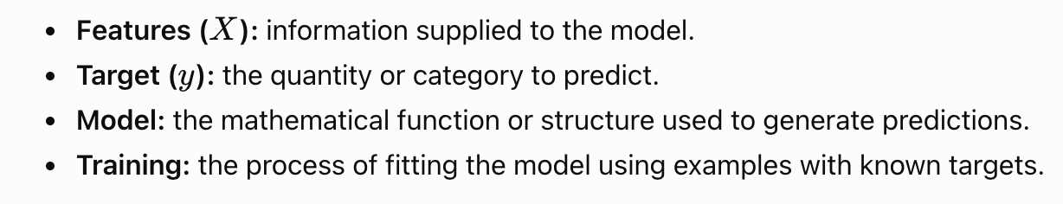
Two major supervised learning tasks:
Regression | Classification
Predicts a numerical quantity | Predicts a category
Example: rainfall amount in mm | Example: wet day or dry day

Slide 7
One row represents one observation at a weather station on a particular date.
Illustrative dataset structure:
Date | Rain today (mm) | Max temp (°C) | Humidity (%) | Rain tomorrow (mm)
Day 1 | 0.0 | 27 | 42 | 0.0
Day 2 | 0.0 | 29 | 38 | 2.5
Day 3 | 2.5 | 25 | 61 | 7.0
Day 4 | 7.0 | 22 | 78 | 0.0
Terminology
Observation: one station-date record.
Feature: a predictor used as input.
Target: the output we want to predict.
Prediction: the model's estimated output.
Residual: actual value minus predicted value in regression.

Slide 8
Regression
Climate question | Target | ML task
How much rain will fall tomorrow? | 6.4 mm | Regression
What will tomorrow's maximum temperature be? | 31.2 °C | Regression
Will tomorrow meet the wet-day definition? | Wet / dry | Binary classification
Which land-cover class appears in a satellite image? | Water / soil / vegetation / built-up | Multiclass classification
Will an agricultural area experience a defined risk category? | Low / medium / high | Multiclass classification or an ordinal modelling approach
Key distinction: A numerical code does not automatically make a target a regression problem. If 0, 1 and 2 represent categories, classification is generally appropriate.

Slide 9
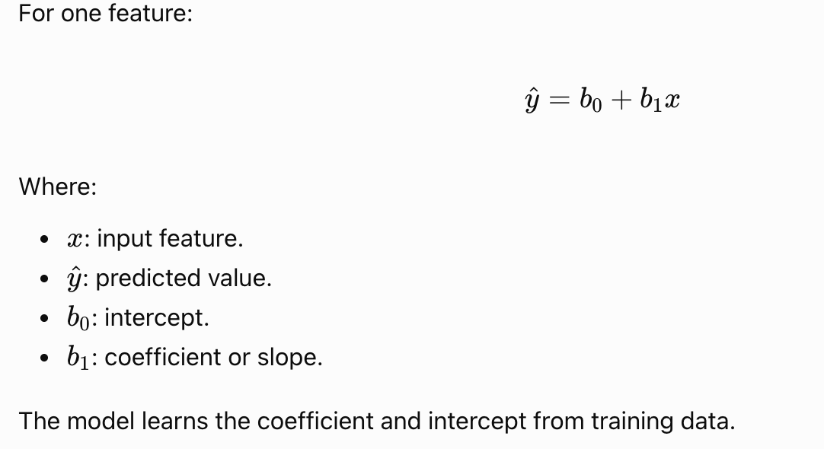
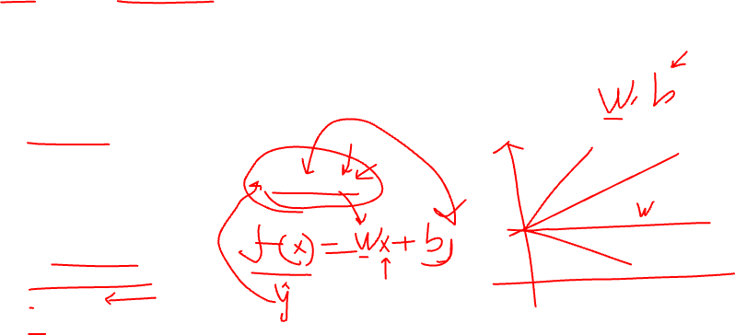
Linear regression: predicting a numerical quantity
What is linear regression?
Linear regression estimates a numerical target using a linear combination of input features.

Slide 10
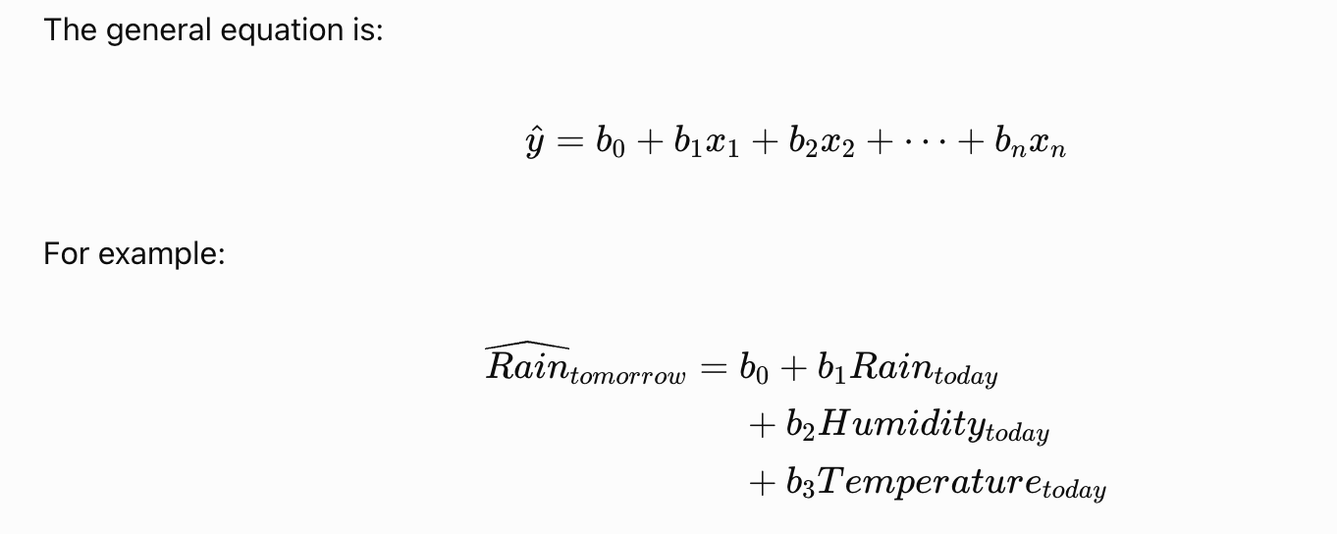
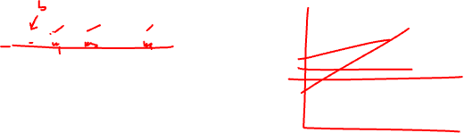
Multiple linear regression: using several features
Climate variables often provide complementary information. A model can use multiple features rather than relying on a single predictor.
Important concepts
More relevant features can provide useful information.
More features do not guarantee better predictions.
Strong correlations between features can make individual coefficients harder to interpret.
Relationships may be nonlinear, seasonal or location-dependent.

Slide 11
Multiple Feature
X1
X2
X3
X4
Y
Size(feet^2) | Number of bedrooms | Number of floors | Age of home (years) | Price
2104 | 5 | 1 | 45 | 460
1416 | 3 | 2 | 40 | 232
1534 | 3 | 2 | 30 | 315
852 | 2 | 1 | 36 | 178
… | … | … | … | …
Dataset
Number of feature
Notes:
We cover the regression and now lets continoue to todays topic. I want to explain multiple feature regression. In the real world, predicting something like the price of a house rarely depends on just one factor. That’s why we move from using a single input to multiple features. This table shows a dataset where each row represents one house, and each column represents a different feature of that house. For example, we consider not only the size of the house (in square feet), but also the number of bedrooms, number of floors, and the age of the home. These are our input variables, labeled as X₁, X₂, X₃, and X₄. The final column is the target variable, Y — the price of the house. This setup helps us understand that more features provide more information to the model, which allows it to make smarter, more accurate predictions. The model will learn which features are more important by assigning different weights to each one

Slide 12

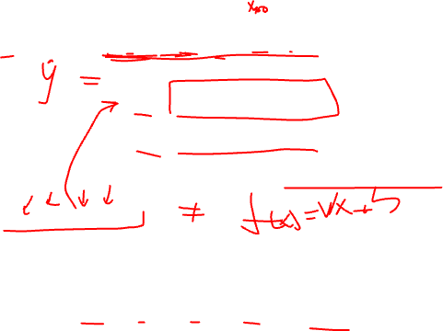
multivariate linear regression
$$f_{\overline{w},b}\left(\overline{x}\right)={x_{1}w}_{1}+{x_{2}w}_{2}+…{x_{n}w}_{n}+b$$
$$\overline{w}= \left[w_{1} w_{2} w_{3}… w_{n}\right]$$
$$\overline{X}= \left[X_{1} X_{2} X_{3}… X_{n}\right]$$
$${x_{1}w}_{1}+{x_{2}w}_{2}+…{x_{n}w}_{n}+b$$
$f_{\overline{w},b}\left(\overline{x}\right)$ = $\overline{w}$. $\overline{x}+b$
$$X^{(2)}=\left[1416 3 2 40\right]$$
$f_{\overline{w},b}\left(\overline{x}\right)=0.1x_{1 }+4x_{2 }+$ $10x_{3 }−2x_{4 }+b (80)$
# bedroom
years
size
# floors
Notes:
Once we have multiple features, our prediction function needs to expand. Instead of a simple linear model like f(x) = wx + b, we now use a linear combination of all features: f(x) = x₁w₁ + x₂w₂ + ... + xₙwₙ + b. Each input feature (like size or number of bedrooms) is multiplied by a learned weight (w), and the results are added together along with a bias term (b). This weighted sum is how our model calculates predictions. The example shows how this works for one data point with actual values filled in — it multiplies the input values by their corresponding weights, adds them, and includes the bias. The key idea here is: each feature contributes to the prediction, but not equally — the model learns how much each one matters during training. This structure forms the basis of multivariate linear regression.

Slide 13
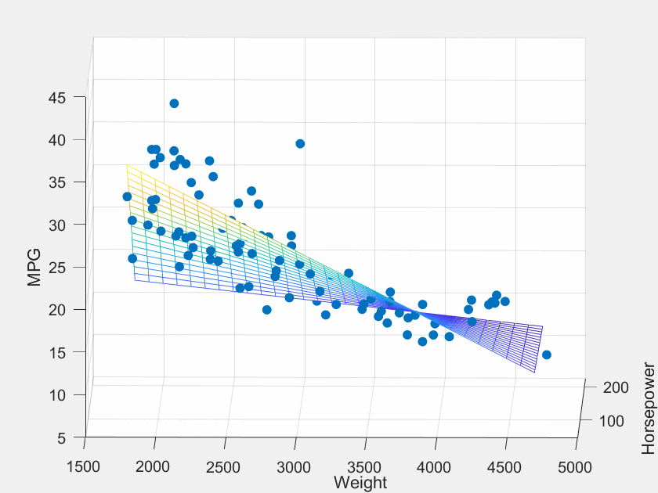
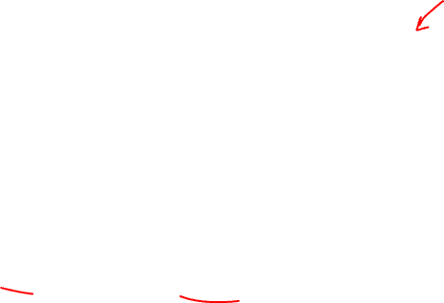
Multiple Feature
MPG = b0 + b1 * horsepower + b2 * weight
use two input features instead of one, the prediction space becomes three-dimensional
Notes:
When we use two input features instead of one, the prediction space becomes three-dimensional. This slide visualizes a model that predicts something like fuel efficiency (MPG) using both horsepower and weight of a car. In this case, the model learns a regression plane, not just a line. Each point on the plane is a prediction made by the model, and the blue dots are actual data points. The goal of training is to make this plane fit as closely as possible to the data — minimizing the distance between predicted values and real values. This visual helps us see that as we add more features, the model doesn't just find a line — it finds a surface in higher dimensions. This is a powerful step forward in building models that can understand more complex relationships between inputs and outputs.

Slide 14
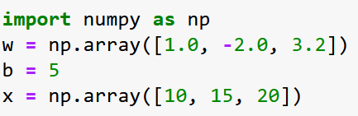
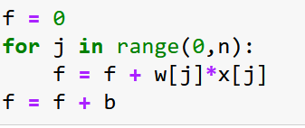
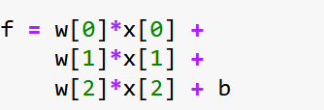

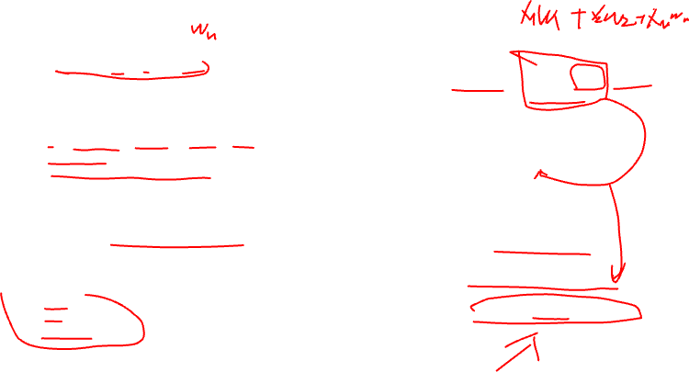
Vectorization
$$\overline{w}= \left[w_{1} w_{2} w_{3}\right]$$
$$f_{\overline{w},b}\left(\overline{x}\right)=\sum_{j= 1}^{n}{{x_{j}w}_{j}+b}$$
$$\overline{x}= \left[x_{1} x_{2} x_{3}\right]$$
WITHOUT VECTORIZATION
VECTORIZATION
$$f_{\overline{w},b}\left(\overline{x}\right)={x_{1}w}_{1}+{x_{2}w}_{2}+{x_{3}w}_{3}+b$$
$f_{\overline{w},b}\left(\overline{x}\right)=\overline{x}$ $\overline{w}+b$
Notes:
now we’re moving into something a bit more practical and super important for writing efficient code — it’s called vectorization. This is a powerful technique we use in Python, especially with NumPy, to make our code not only shorter but also much faster.
🧠 So what does it mean conceptually?
Well, think about this equation:
f(x) = w₁x₁ + w₂x₂ + w₃x₃ + b.
Normally, we’d compute each multiplication and addition step-by-step. That’s okay for small problems, but imagine doing this for thousands or even millions of data points. Writing a for loop every time? That would be slow and make your code messy. This is where NumPy steps in and says: “Just give me the whole vectors — I’ll handle it all at once.”
🔍 Let’s walk through the slide examples together:
🟢 At the top, we define our vectors:
We’ve got w = [1.0, -2.0, 3.2] and x = [10, 15, 20], with a bias b = 5.
These represent our weights, inputs, and the bias term. So far, pretty straightforward.
❌ Now, on the bottom left — Without Vectorization:
We calculate the output manually like this:
f = w[0]*x[0] + w[1]*x[1] + w[2]*x[2] + b
It works, but it’s clunky. If you had 50 features instead of 3, this would get out of hand quickly. It’s not scalable and becomes hard to read or maintain. Also, more code = more chances to make mistakes.
✅ And on the right — With Vectorization:
Here’s the magic line:
f = np.dot(w, x) + b
One line, same result. np.dot(w, x) takes care of all the multiplications and summing. Then we just add the bias. It’s clean, fast, and readable.
🔁 In the middle, you can also see the traditional Python way using a loop:
f = 0 for j in range(0, n): f += w[j] * x[j] f += b
Again, it works, but it’s slower and longer. That’s why we use vectorization — for performance, simplicity, and clarity. As you can see, fewer lines of code often means fewer bugs and faster computation.

Slide 15



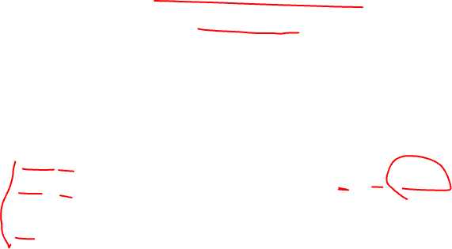
Gradient Descent
$$\overline{w}= \left[w_{1} w_{2} {… w}_{16}\right]$$
$$\overline{d}= \left[d_{1} d_{2} …{ d}_{16}\right]$$
WITHOUT VECTORIZATION
VECTORIZATION
$$w_{1}=w_{1}−0.1d_{1}$$
$$w_{2}=w_{2}−0.1d_{2}$$
$$\overline{w} =\overline{w}−0.1d_{1}$$
$$…$$
$$w_{16}=w_{16}−0.1d_{16}$$
Notes:
now let’s take what we learned about vectorization and apply it to gradient descent. Remember, in gradient descent we update our weights using the formula: w = w - learning_rate × gradient. So here, we have a weight vector w with 16 elements and a gradient vector d with 16 corresponding values. If we don’t use vectorization, we would have to update each weight one by one — like w[0] = w[0] - 0.1 * d[0], then w[1] = w[1] - 0.1 * d[1], and so on. It works, but it’s clearly repetitive and inefficient. We’d have to write a loop, as shown in the bottom left — again, more lines of code, more room for mistakes. But with vectorization, look at the right side — we can update all weights at once with this single line: w = w - 0.1 * d. That’s it! NumPy takes care of element-wise multiplication and subtraction internally. It’s not just cleaner — it’s also much faster, especially when you’re working with large models or deep neural networks. So again, vectorization helps us write code that is simpler, faster, and way easier to read and debug.

Slide 16
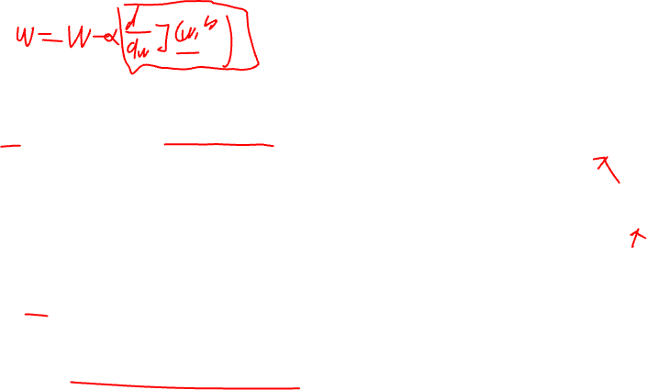
One Feature
More Than One Feature
$$w=w − α\frac{1}{m}\sum_{i=1}^{m}{f_{\overline{w},b}\left(x^{\left(i\right)}\right)−y^{\left(i\right)})∗x^{\left(i\right)}}$$
$$w_{1} =w_{1}− α\frac{1}{m}\sum_{i=1}^{m}{f_{\overline{w},b}\left(x^{\left(i\right)}\right)−y^{\left(i\right)})∗x^{\left(i\right)}}$$
$\frac{∂}{∂w_{j}}$ $J\left(\overline{w},b\right)$
$$…$$
$\frac{∂}{∂w_{j}}$ $J\left(\overline{w},b\right)$
$$w_{n} =w_{n}− α\frac{1}{m}\sum_{i=1}^{m}{f_{\overline{w},b}\left(x^{\left(i\right)}\right)−y^{\left(i\right)})∗x^{\left(i\right)}}$$
$$b=b − α\frac{1}{m}\sum_{i=1}^{m}{f_{\overline{w},b}\left(x^{\left(i\right)}\right)−y^{\left(i\right)})}$$
$$b=b − α\frac{1}{m}\sum_{i=1}^{m}{f_{\overline{w},b}\left(x^{\left(i\right)}\right)−y^{\left(i\right)})}$$
Simultaneously update w,b
Simultaneously update w (for j = 1, 2, …. m) and b
Notes:
Lets look how can we update the weight and bias for one feature and more than one feature.
During training, your goal is to find the optimal values for the weight and bias that minimize the cost function. You use an optimization algorithm like gradient descent to achieve this. The weight and bias updates are calculated based on the gradient of the cost function with respect to these parameters.
Mathematically, the weight and bias updates might look like this in each iteration:
New Weight = Old Weight - Learning Rate * Gradient of Weight
New Bias = Old Bias - Learning Rate * Gradient of Bias
Weight and Bias Update with More Than One Feature:
When you have multiple features (let's say X1, X2, X3, ...), the concept remains the same, but the equation for prediction and the updates involve all the features.
Prediction = Weight1 * X1 + Weight2 * X2 + Weight3 * X3 + ... + Bias
During training, you update each weight and the bias based on the gradient of the cost function with respect to these parameters:
New Weight1 = Old Weight1 - Learning Rate * Gradient of Weight1 New Weight2 = Old Weight2 - Learning Rate * Gradient of Weight2 ...
New Bias = Old Bias - Learning Rate * Gradient of Bias
Summary:
In both cases, weights determine the importance of each feature in the prediction.
The bias shifts the prediction up or down.
During training, you update weights and bias using the gradient of the cost function with respect to these parameters, multiplied by the learning rate.
Gradient descent adjusts the parameters iteratively to minimize the cost function and improve the model's performance.

Slide 17
Question:
You are working on a regression problem with multiple input variables to predict house prices. You have gathered data on the following features for each house: square footage, number of bedrooms, number of bathrooms, and distance from the city center. You want to build a linear regression model for this task.
Which of the following statements about the assumptions of linear regression is correct in this context?
A) There are no assumptions for linear regression when dealing with multiple input variables.
B) The assumption of multicollinearity is not relevant since there is only one dependent variable.
C) It is important to check for multicollinearity among the independent variables.
D) Assumption of linearity only applies to single input variable regression, not multiple input variable regression.
Notes:
Multicollinearity is a statistical phenomenon. It can occurs when two or more independent variables in a regression analysis are highly correlated with each other. In other words, it means that some of the independent variables in a multiple regression model can be predicted linearly from the others.
A - This statement is not correct. Linear regression still has assumptions even when dealing with multiple input variables. These assumptions include linearity, independence of errors, homoscedasticity (constant variance of errors), and normality of errors.
B - Multicollinearity refers to the correlation between independent variables in the regression model. It is relevant when you have multiple independent variables, regardless of the number of dependent variables.
C - When you have multiple independent variables in a linear regression model, it is important to check for multicollinearity. Multicollinearity can lead to unstable coefficient estimates and make it challenging to interpret the individual effects of each independent variable.
D- The assumption of linearity applies to both single and multiple input variable regressions. It means that the relationship between the independent variables and the dependent variable should be linear.

Slide 18




Alternative optimization method to gradient descent
Alternative optimization method to gradient descent
Normal Equation
Only for linear regression
Solve for w, b without iteration
Notes:
Can you say alternative optimization method to gradient descent?
The Normal Equation is a kind of closed-form analytical solution. It is directly computes the optimal parameters for a linear regression model. It's an alternative to iterative optimization algorithms like gradient descent. The Normal Equation works particularly well when the number of features is relatively small Because it icomputes the inverse of a matrix.
here the teta equation. I dont want to go through. I will send you a link to how to derive it. https://www.geeksforgeeks.org/ml-normal-equation-in-linear-regression/ please check the link.
What is the advantages and disadvantages
Advantages:
The solution is obtained in one step, so there's no need for iteration.
For small to moderate-sized datasets, the Normal Equation can be efficient and accurate.
Disadvantages:
For large datasets with a high number of features, computing the inverse of X^T X can be computationally expensive and may lead to memory issues.
It doesn't work well or may even fail if the matrix X^T X is close to singular (not invertible) due to multicollinearity or other reasons.
It's specifically designed for linear regression; it doesn't generalize to other models like neural networks or more complex machine learning algorithms.

Slide 19
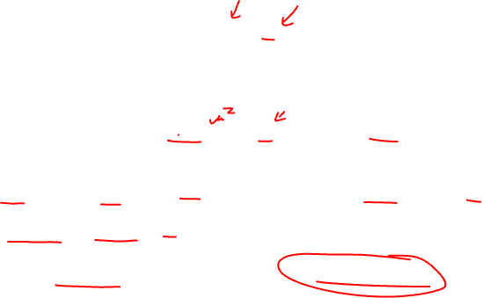
Feature Scaling
$${{price= x}_{1}w}_{1}+{x_{2}w}_{2}+b$$
size
# bedrooms
$$x_{1}=2000$$
$$x_{2}=5$$
$$price=500k$$
$$w_{1}=50$$
$$w_{2}=0.1$$
$$b=50$$
$$w_{1}=0.1$$
$$w_{2}=50$$
$$b=50$$
$$price=50∗2000+0.1∗5+50$$
$$price=0.1∗2000+0.1∗50+50$$
$$price=100,050.5 k$$
$$price=500 k$$
Notes:
Let’s take a look at the relationship between the size of a feature and how big are or how different from each other. When they so different from each other we can do feature scaling process. What is feature scaling?
we use to make sure that these features are all in a similar range or scale. Why is that important?
Well, some machine learning algorithms use distances between data points to make decisions. If the features are on very different scales, the algorithm might give more weight to features with larger values, even if they're not necessarily. This can lead to biased or less accurate.
Here you see 2 randomly selected weights and biases. The first one results in 100k. For the first one this is not a very good set of parameter choices for w1 and w2. Now let's take a look at another possibility. Say w1 and w2 were the other way around. W1 is 0.1 and w2 is 50 and b is still also 50. In this choice of w1 and w2, w1 is relatively small and w2 is relatively large, 50 is much bigger than 0.1. So here the predicted price is 0.1 times 2000 plus 50 times five plus 50. The first term becomes 200k, the second term becomes 250k, and the plus 50. So this version of the model predicts a price of $500,000 which is a much more reasonable estimate and happens to be the same price as the true price of the house.
You saw the one feature change how much effect the result right? Lets see the countor plot.

Slide 20
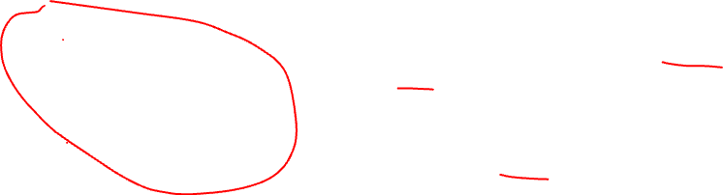
# bedrooms
$$J\left(\overline{w},b\right)$$
$$5$$
$$0$$
$$300$$
$$2000$$
$$w_{1} size$$
$$1$$
# bedrooms rescaled
$$J\left(\overline{w},b\right)$$
$$0$$
$$1$$
$$w_{1} size rescaled$$
Notes:
I want to show the plots before feature scaling and after feature scaling.
First one is normal plot other one ise scaled and you also see the cost function plot.
When we do feature scale how J(W,B) plot change? Lets look first cost function plot
Let me first remind you what is cost function actually. cost function plot shows the value of the cost function 𝐽(¯𝑤,𝑏) for different combinations of the model's parameters.The cost function quantifies how well the model's predictions match the actual data. The plot can provide insights into the shape of the cost function's surface. It might show if the cost function has multiple local minima or if it's a relatively simple bowl-shaped function.
Lets think about how they relate.
When you perform feature scaling, you're essentially transforming your feature. New one is more uniform and doesn't favor any particular feature due to its scale. This can lead to a more symmetrical and well-behaved cost function plot. The surface of the cost function becomes smoother. It can help optimization algorithms converge faster and more consistently.
In the context of gradient descent, feature scaling can help by:
Reducing the number of iterations needed for convergence.
Preventing certain features from dominating the optimization process due to their large scales.
When both feature scaling and the cost function plot are considered, you aim for smoother convergence during training. Feature scaling creates a more balanced landscape for optimization, while the cost function plot helps you visualize how the optimization process progresses across different parameter combinations.
In summary, feature scaling and the cost function plot are two important concepts. It can contribute to effective training and optimization of machine learning models

Slide 21
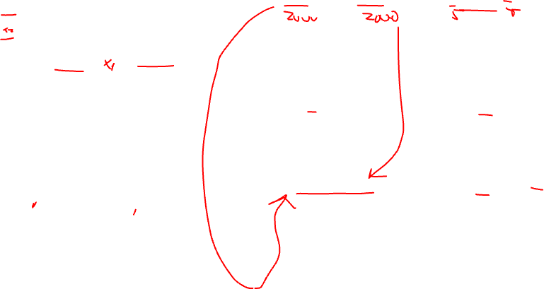
Feature Scaling
$${300<x}_{1 }<2000$$
$${0<x}_{2}<5$$
$$5$$
$$0$$
$$300$$
$$2000$$
$$x_{1,scaled }=\frac{x_{1 }}{max}=\frac{x_{1 }}{2000}$$
$$x_{2 }=\frac{x_{2 }}{max}=\frac{x_{1 }}{5}$$
$$1$$
$$0$$
$$1$$
$${0.15<x}_{1 }<1$$
$${0<x}_{2 }<1$$
Notes:
Here let see the example how can we do feature scaling. In this case we just find the maximum value for 2 input and divide them to max. And you can seeour max value has to be 1.

Slide 22
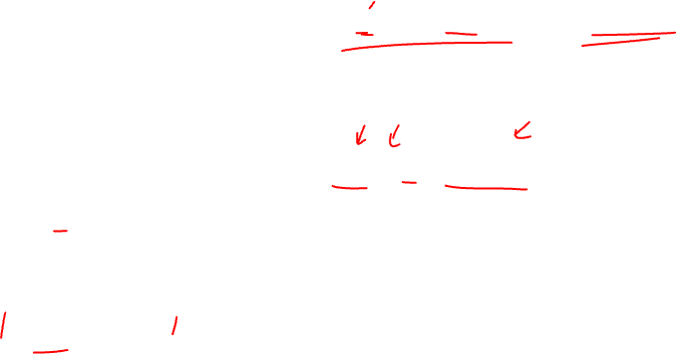
Mean Normalization
$${300<x}_{1 }<2000$$
$${0<x}_{2}<5$$
$$5$$
$$0$$
$$300$$
$$2000$$
$$x_{1 }=\frac{{(x}_{1 }−μ_{1 })}{\max{− min}}=\frac{{(x}_{1 }−600)}{2000{− 300}}$$
$$x_{2 }=\frac{{(x}_{2 }−μ_{2 })}{\max{− min}}=\frac{{(x}_{1 }−2.3)}{5{− 0}}$$
$$1$$
$$−1$$
$$1$$
$${−0.46<x}_{2 }<0.54$$
$${−0.18<x}_{1 }<0.82$$
$$−1$$
Notes:
Lets look another normalization type. Mean normalization aims to shift the values of your features. they have a mean of 0. This technique is useful when you want to center your data around zero. It's particularly handy when you have features with different units and scales, and you want to remove any bias introduced by those differences.
Lets look hoe can we do mean normalization
Calculate the Mean: First, you calculate the mean (average) of the feature you're working with.
Subtract the Mean: For each value in the feature, you subtract the mean calculated in the previous step. This centers the data around zero. The resulting values are called "mean-centered" values.
Use the Mean-Centered Values: Now you have transformed your feature so that its values have a mean of 0. You can use these mean-centered values in your machine learning algorithm.

Slide 23
Z Score Normalization
$${300<x}_{1 }<2000$$
$${0<x}_{2}<5$$
$$5$$
$$0$$
$$300$$
$$2000$$
$$x_{1 }=\frac{{(x}_{1 }−μ_{1 })}{σ_{1 }}=\frac{{(x}_{1 }−600)}{450}$$
$$x_{2 }=\frac{{(x}_{2 }−μ_{2 })}{σ_{2 }}=\frac{{(x}_{1 }−2.3)}{1.4}$$
$$2$$
$$−1$$
$$3$$
$${−1.6<x}_{2 }<1.9$$
$${−0.67<x}_{1 }<3.1$$
$$−2$$
Notes:
This method transforms the features so that they have a mean of 0 and a standard deviation of 1. It's like shifting and stretching the data so it's centered around 0 and the spread is consistent. The formula for standardization is:
This is useful when your features have different units or ranges.
To implement Z-score normalization, you need to calculate something called the standard deviation of each feature. And then we are implementing the formula for both upper bound and lower bound.

Slide 24
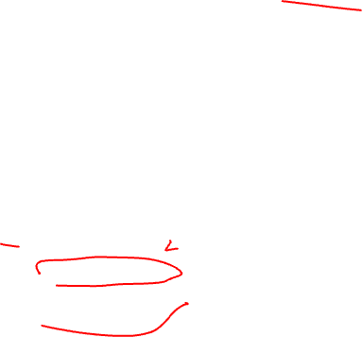
Feature Scaling
$${−1≤ x}_{j}≤1$$
$${−3≤ x}_{j}≤3$$
Acceptable Range
$${−0.3≤ x}_{j}≤0.3$$
$${0≤ x}_{j}≤3$$
Acceptable
$${−2≤ x}_{j}≤0.5$$
Acceptable
$${−100≤ x}_{j}≤100$$
Too large
$${−0.001≤ x}_{j}≤0.001$$
Too small
Notes:
So In some machine learning algorithms, like k-means clustering, gradient descent for training neural networks, or support vector machines, the algorithm's performance can improve significantly when features are scaled. Scaling helps the algorithm converge faster and might obtain to a more accurate model.
But, not all algorithms require feature scaling. For example, tree-based algorithms like decision trees and random forests are not sensitive to feature scaling, so you might not need to scale your features when using these algorithms.
If we look at the example here, -1 to 1, -3 to 3 and -0.3 to 0.3 are acceptable ranges for us. Lets look first example. What do you is this acceptable? yes

Slide 25
Question:
You're working on a machine learning project that involves a dataset with features of varying scales. The algorithm you plan to use is sensitive to the scale of input features. Which of the following statements about feature scaling is true?
A) Feature scaling is only necessary for categorical features.
B) Feature scaling helps improve the accuracy of algorithms that are not affected by feature scales.
C) Feature scaling is primarily important for classification tasks, not regression tasks.
D) Feature scaling is important for algorithms like gradient descent-based optimization.
Notes:
A) Feature scaling is only necessary for categorical features: Feature scaling is relevant for both categorical and numerical features. Categorical features often require additional preprocessing like one-hot encoding, but scaling is important mainly for numerical features due to their varying ranges.
B) Feature scaling helps improve the accuracy of algorithms that are not affected by feature scales: Feature scaling is not about improving the accuracy of unaffected algorithms. It's about ensuring that algorithms sensitive to feature scales can perform optimally.
C) Feature scaling is primarily important for classification tasks, not regression tasks: Feature scaling is important regardless of whether the task is classification or regression. It's related to the algorithm's sensitivity to the scale of input features, rather than the specific task.
training models (like linear regression, logistic regression, neural networks, etc.), involve optimizing a cost function using gradient descent. When features have different scales, the cost function can have elongated and skewed contours, making convergence slower and less efficient. Feature scaling helps gradient descent algorithms converge more quickly and consistently.

Slide 26
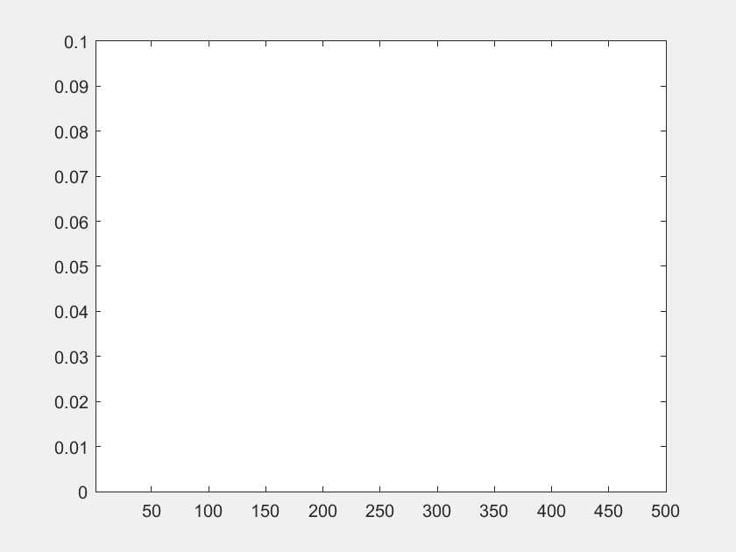
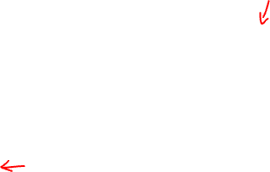
How can we understand gradient descent is working correctly
$J\left(\overline{w},b\right)$
Mathematical Accuracy
Convergence Behavior
Learning Rate
Gradient Checks
Plot and Visualizations
# iteration
Notes:
Here's how you might go about ensuring that gradient descent is working correctly:
1. Mathematical Accuracy: First and foremost, you need to ensure that the mathematical calculations involved in gradient descent are accurate. Verify that you're computing the gradient of the cost function correctly with respect to the model parameters.
2. Convergence Behavior: Gradient descent should move towards the minimum of the cost function over iterations. Monitor the behavior of the cost function over time. It should decrease in value, indicating that the algorithm is approaching a solution.
3. Learning Rate: The learning rate is a crucial hyperparameter in gradient descent. Verify that the learning rate is appropriately set. If it's too high, gradient descent might oscillate or even diverge. If it's too low, convergence might be slow.
4. Gradient Checks: Perform gradient checks where you compare the gradients computed analytically (using calculus) with gradients computed numerically (using small perturbations). If they match closely, it's a sign that your gradient computation is correct.
5. Plots and Visualizations: Plot the cost function values over iterations. You should see a downward trend, indicating that the algorithm is progressing. Also, visualize the path that the parameter updates take towards convergence. This can provide insights into how gradient descent is behaving. Like our plot

Slide 27
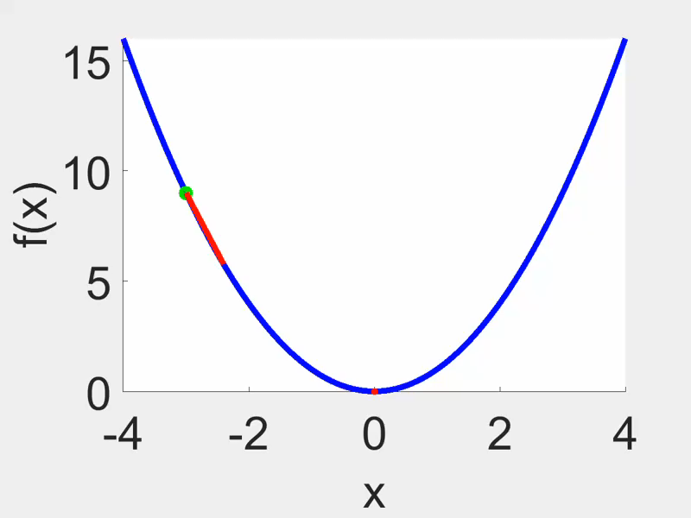
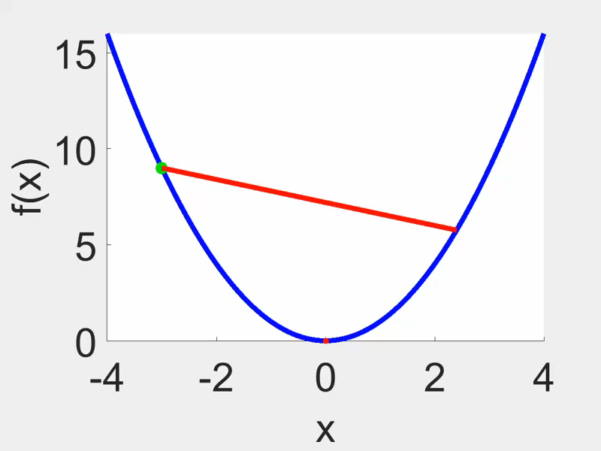
$$J\left(\overline{w},b\right)$$
$$J\left(\overline{w},b\right)$$
# iteration
# iteration
If learning rate is too small, gradient descent takes too much time to converge
Proper learning rate
Big learning rate
Notes:
When you're working with gradient descent, you're trying to find the values of ¯𝑤 and 𝑏 that minimize the cost function 𝐽(¯𝑤,𝑏). The learning rate is a hyperparameter that determines the step size taken in each iteration of gradient descent. It influences how quickly the algorithm converges to the optimal solution.
Now, let's explore the differences in the behavior of the 𝐽(¯𝑤,𝑏) plot for large and small learning rates:
1. Large Learning Rate: With a large learning rate, the algorithm takes large steps towards the minimum of the cost function in each iteration. This can lead to some issues:
Overshooting: If the learning rate is too large, gradient descent might overshoot the minimum of the cost function. This means it could bounce back and forth across the minimum without converging.
Divergence: In extreme cases, a very large learning rate might cause gradient descent to diverge. This means that the algorithm moves away from the optimal solution instead of towards it.
In the 𝐽(¯𝑤,𝑏) plot with a large learning rate, you might observe that the cost function decreases rapidly at first but then starts oscillating around the minimum or even increasing again due to overshooting.
2. Small Learning Rate: With a small learning rate, the algorithm takes smaller steps towards the minimum of the cost function in each iteration. This can lead to these outcomes:
Slow Convergence: A very small learning rate might cause gradient descent to converge very slowly. It takes many small steps to reach the optimal solution.
Stuck in Local Minima: In some cases, a very small learning rate might cause gradient descent to get stuck in local minima of the cost function, never reaching the global minimum.
In the 𝐽(¯𝑤,𝑏) plot with a small learning rate, you might observe a slow and steady decrease in the cost function value over iterations. It might take a longer time to converge to the optimal solution.

Slide 28
Polynomial Regression
$$f_{\overline{w},b}\left(\overline{x}\right)={x_{1}w}_{1}+{x_{2}^{2}w}_{2}+b$$
$$f_{\overline{w},b}\left(\overline{x}\right)={x_{1}w}_{1}+{x_{2}^{2}w}_{2}+{x_{2}^{3}w}_{2}+ b$$
Notes:
Imagine you're trying to predict something like the price of houses based on just one feature, let's say "House Size." If you use a simple linear regression model, you'd draw a straight line that best fits the data points. However, sometimes a straight line might not accurately capture the relationship between the feature and the target.
That's where Polynomial Regression comes in. Polynomial Regression is a type of regression analysis that allows you to model relationships between variables with curves instead of straight lines. It's like bending the line to better match the data points.
Here's how Polynomial Regression works:
Adding Complexity: With Polynomial Regression, you introduce higher-order terms of the feature. Instead of a simple line, you use a polynomial equation like y = b₀ + b₁x + b₂x² + ... + bₙxⁿ, where n is the degree of the polynomial. This allows the line to curve to better fit the data.
Choosing Degree: The degree of the polynomial determines how complex the curve can be. A quadratic polynomial (degree 2) adds a bend to the line, while higher degrees can create more complex curves.
Fitting the Model: The goal is still to find the best-fitting line, but now it's a curve. This involves finding the coefficients b₀, b₁, b₂, etc., that minimize the difference between the predicted values and the actual target values (like with linear regression).
In summary, Polynomial Regression is a way to extend linear regression to model more complex relationships between variables. It's useful when a simple straight line doesn't accurately represent the data's behavior. By introducing curves into the equation, you can better capture patterns and make more accurate predictions. Just remember, while it's powerful, choosing the right degree of the polynomial is crucial to prevent overfitting.

Slide 29
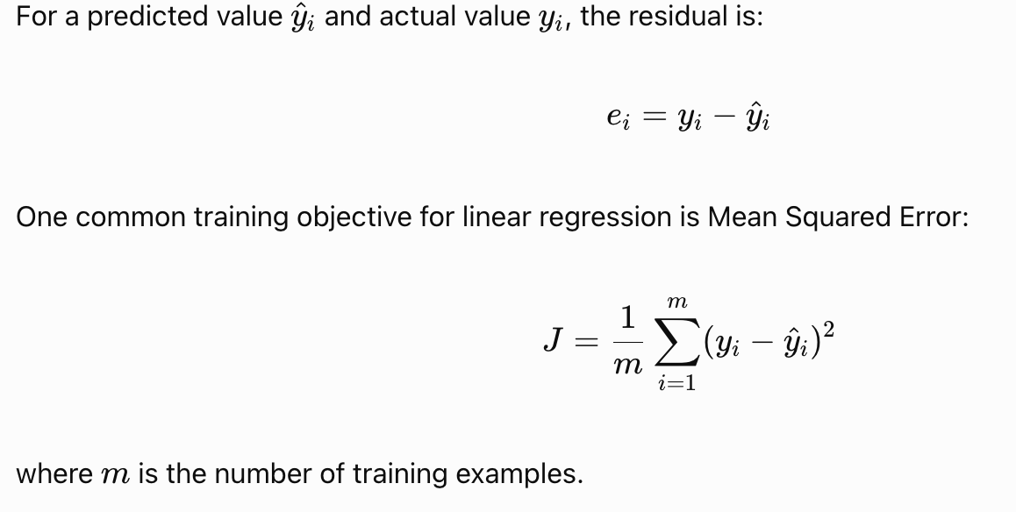
How does regression learn?
Training means finding model parameters that minimise a defined loss or cost function.
For each training example:
The model receives input features.
It calculates a predicted value.
The prediction is compared with the observed target.
The learning algorithm adjusts model parameters to reduce the objective.
The process continues until the stopping criterion is met.

Slide 30
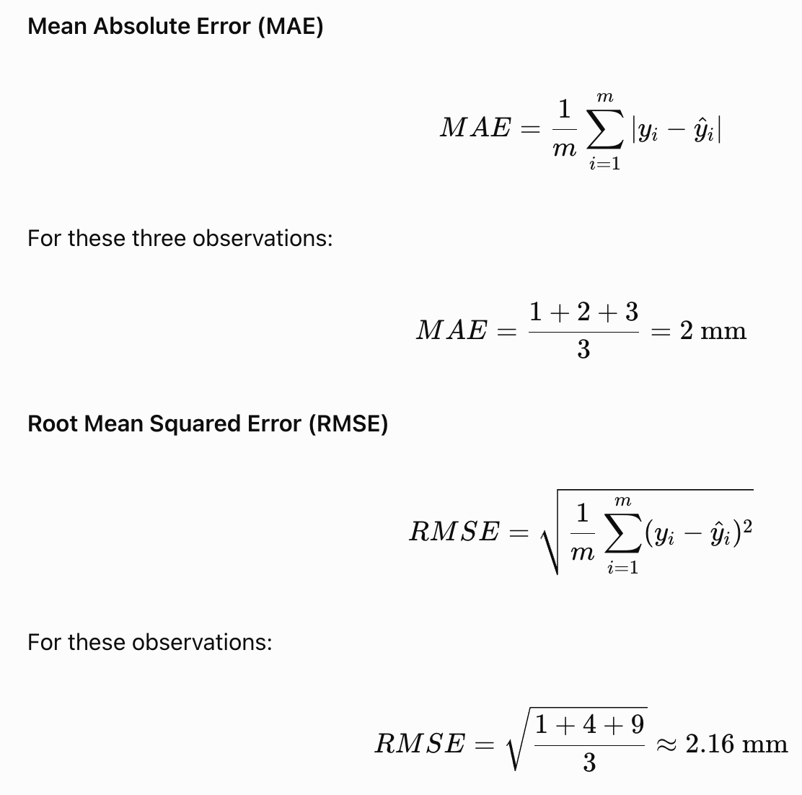
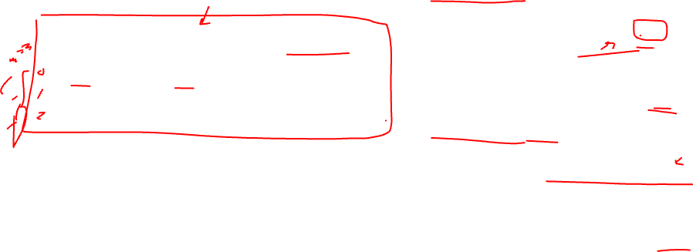
Evaluating regression: MAE and RMSE
A model must be evaluated on data it did not use to fit its parameters.
Consider three held-out observations:
Actual rainfall | Predicted rainfall | Absolute error
0 mm | 1 mm | 1 mm
5 mm | 3 mm | 2 mm
12 mm | 9 mm | 3 mm
How to interpret the metrics
Both metrics are expressed in the target's units.
Lower scores indicate smaller errors on the same evaluation dataset.
RMSE penalises large errors more strongly than MAE.
Neither metric indicates whether a forecast is systematically too high or too low.

Slide 31
Always compare against a baseline
How do we know machine learning actually improves a prediction?
A baseline is a simple, transparent prediction method used as a point of comparison.
For rainfall regression, possible baselines include:
Predicting zero rainfall for every observation.
Predicting an appropriate historical seasonal average.
Using a persistence or climatology baseline, where appropriate to the task.
For classification, a baseline could predict the most common class in the training dataset.
Evaluation procedure
Define the baseline before comparing models.
Generate baseline predictions for the same held-out dates.
Generate ML predictions for those dates.
Calculate the same metric for both.
Report whether the ML model improves on the baseline.

Slide 32
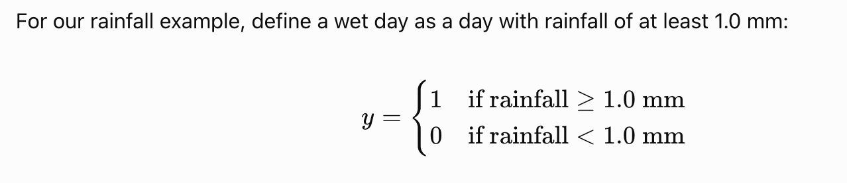
Classification
Classification predicts a category rather than an unrestricted numerical quantity.
In binary classification, the target has two classes:
Class 0: negative class.
Class 1: positive class.
Multiclass classification: Predicts one of more than two classes, such as low, medium or high drought risk.

Slide 33
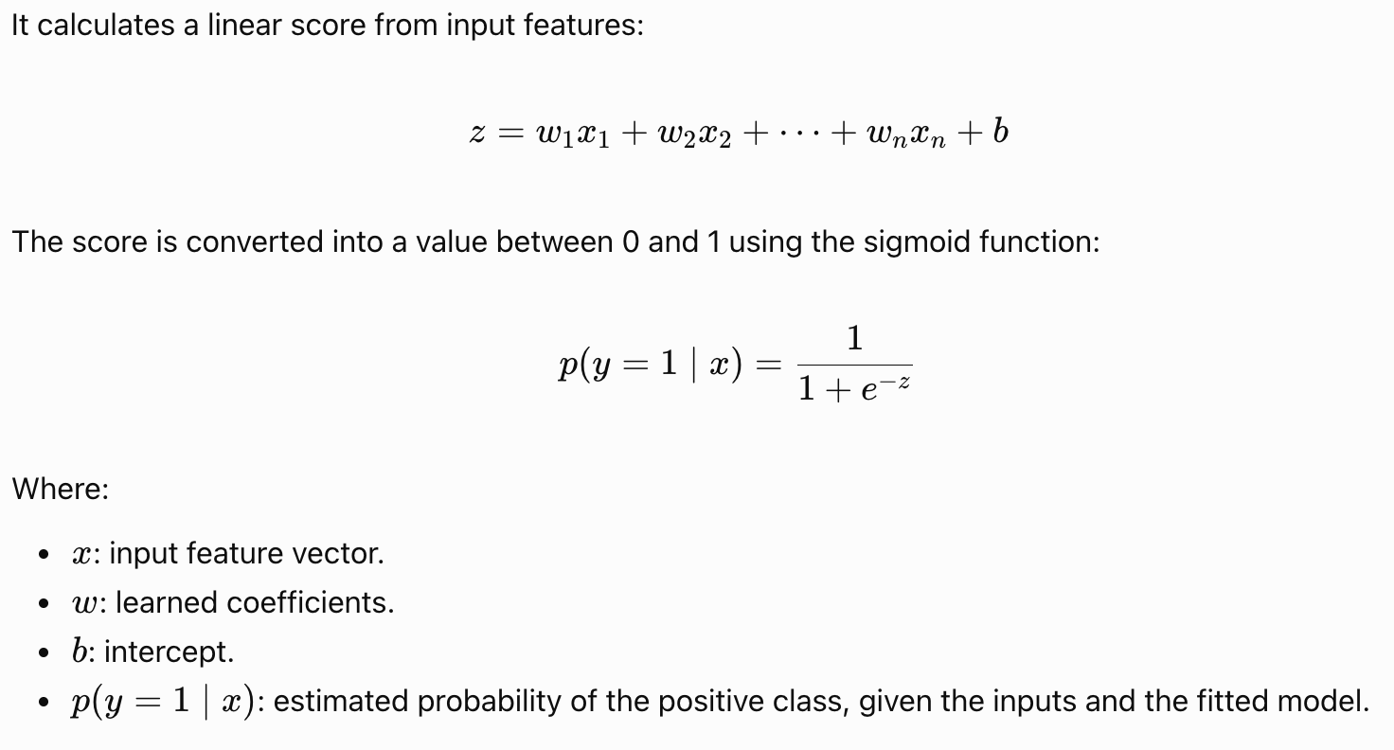
Logistic regression: estimating class probabilities
Despite its name, logistic regression is commonly used for classification.

Slide 34
Example
The model outputs:
\[ p(\text{wet day}\mid x)=0.78 \]
Interpretation: the fitted model assigns a 78% estimated probability to the wet-day class for this observation.
Important: The estimated probability is not a guarantee. Its reliability depends on the model, training data and whether the model is appropriately calibrated for the deployment setting.

Slide 35
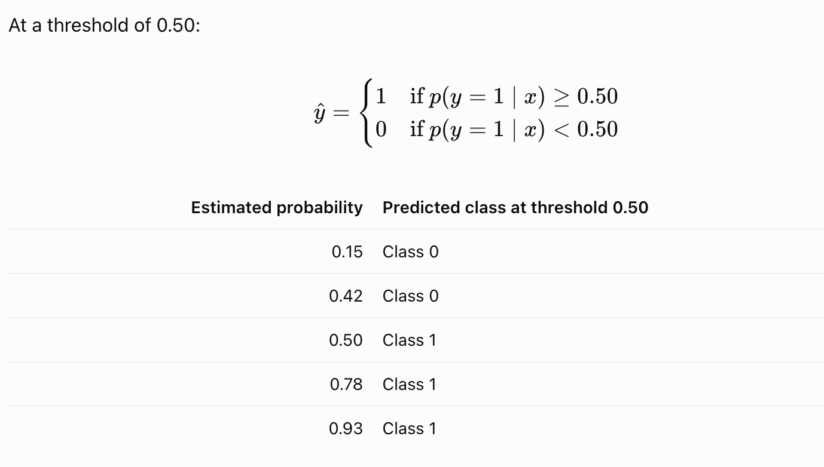
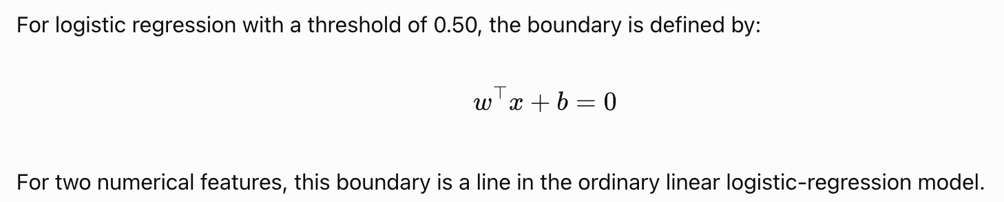
From a probability to a class
The decision threshold determines how probabilities are converted into predicted classes.
What is the decision boundary?
It is the boundary in feature space at which the model changes its predicted class according to the selected threshold.

Slide 36
Why the decision threshold matters
A threshold of 0.50 is a starting point, not a universal optimum.
Consider a model identifying potential drought-stress events.
Lower threshold: More observations may be flagged as positive. This can increase recall, but it may also increase false positives.
Higher threshold: Fewer observations may be flagged. This may reduce false positives but can increase missed events.
Select the threshold using:
Validation data not used for final testing.
The consequences of false positives and false negatives.
The desired precision and recall.
Any operational constraints on how many alerts users can investigate.

Slide 37


Classification problem
$$f_{w,b}\left(\overline{x}\right)=w.x+b$$
$$f_{w,b}\left(\overline{x}\right)=w.x+b$$
Class1
Class1
1
1
0.5
threshold
0.5
threshold
Class2
Class2
0
0
Notes:
Today we will learn what is classification and how can we do this classification? We already talk about the classification regression and their differences.
In regression, your output range is much wider. But in a classification problem it is much narrower. For example, annual profit forecast. This gives a result in a very wide scale, but the classification of movies, books can be 5 categories. It turns out that the best technique for classification issues is not linear regression. Now that we understand why, we can go on to a new approach called logistic regression. This is currently one of the most often applied learning algorithms.
Here are some examples of classification problem. The problm is yes or no like yes mean 1 no mean 0. This 0-1 classificaon call binary classification. Lets talk why linear regression bad for S-spahed data. Here 0.5 is our threshold value and the value where the linear line crosses the threshold point shows at which values our class is separated into 2. As can be seen in this example, our data is correctly separated by linear regression. However, if a new data is added to Class 1 and this data is far away from x data as can be seen here and still in class 1, the linear line changes in this way and if we think that it is separated as class1 and class2 from the point where it cuts the threshold, we see that it will label 3 data from class1 as class 2. Therefore linear regression is not a suitable option.

Slide 38
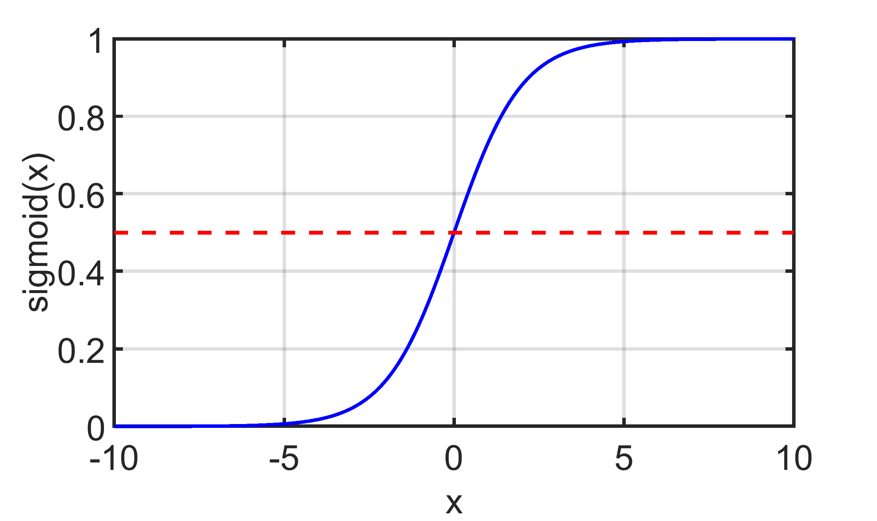

Classification problem
Class1
1
Class2
0
$$g\left(z\right)=\frac{1}{1+e^{−z}}$$
Notes:
We learn why yhe linear regression doesnt fit. And you heard a bit logistic regression. Lets dive a bit more.
Let’s first look at the graph on the left. You’ll see two distinct classes—Class 0 and Class 1—clearly separated. Our goal is to learn a model that can distinguish between them. Unlike linear regression, it tries to draw a straight line to fit values, logistic regression is designed to output values between 0 and 1, it makes it perfect for classification problems.
Now, take a look at the plot on the right. That blue curve you see is called the sigmoid function, defined as:
g(z) = 1 / (1 + e^(–z))
Here, z is a linear combination of the input features and their weights, just like in linear regression. But instead of returning just any number, this sigmoid squashes it into a range between 0 and 1. So the output of the model is not a continuous value anymore, but a probability.
If the sigmoid function returns a value greater than 0.5, we predict the data point belongs to Class 1. If it’s less than 0.5, we predict Class 0. That red dashed line at 0.5 is our decision boundary.
So in summary, logistic regression transforms a linear model into a classification tool by passing the output through the sigmoid function. It’s especially useful for binary classification problems and gives us a probabilistic interpretation, which helps us make more informed decisions.

Slide 39











Decision Boundary
$$g\left(z\right)$$
$Class 1 when y=1$
$$Class 2 when y=0$$
$p(y=1|x;$ϴ) + $p(y=0|x;$ϴ) = 1
$p(y=1$) = $\frac{1}{1+e^{−{\text{ϴ}}^{ T}X}}$
$$g\left(z\right)=\frac{1}{1+e^{−z}}$$
$$f_{\overline{w},b}\left(\overline{x}\right)=0.7?$$
$$f_{\overline{w},b}\left(\overline{x}\right)=0.3?$$
$$f_{\overline{w},b}\left(\overline{x}\right)>0.5 class1$$
$$f_{\overline{w},b}\left(\overline{x}\right)<0.5 class2$$
$$z=\overline{w}\overline{.x}+b$$
Notes:
Now let’s dig a little deeper into how logistic regression makes decisions, specifically how we define a decision boundary.
First, take a look at the sigmoid curve on the left. This is the same sigmoid function we saw earlier:
g(z) = 1 / (1 + e^(–z)),
where z = w·x + b, a linear combination of our input features. This function takes any real number and maps it into the range (0, 1), making it perfect for probability predictions.
The red dashed line at 0.5 is critical. This is our threshold. If the sigmoid output g(z) is greater than 0.5, we classify the data point as Class 1. If it's less than 0.5, we classify it as Class 0. This threshold defines our decision boundary.
Now, look at the math on the right side. We express the probability of class membership using:
p(y = 1) = 1 / (1 + e^(–θᵀx))
This equation gives us the probability that an input belongs to Class 1. The model assumes: The probability that y equals 1 given x and theta, plus the probability that y equals 0 given x and theta, equals 1.
Below that, you see two examples:
If f(x) = 0.7, that’s greater than 0.5 → we predict Class 1.
If f(x) = 0.3, that’s less than 0.5 → we predict Class 0.
So the decision boundary isn’t always at a specific x-value like in linear regression. It depends on the weights (w) and bias (b). That boundary is defined in the feature space and separates the input regions classified as Class 1 vs Class 0.
In short, logistic regression uses the sigmoid function to turn a linear score into a probability, and then applies a simple rule: compare that probability to 0.5 to make a classification decision.

Slide 40




Decision Boundary
$$x_{2}$$
$$w^{T}x+w_{0}=constant$$
$$w^{T}x+w_{0}=constant$$
$$w$$
$$x_{1}$$
Notes:
Now let’s talk about one of the most important ideas in classification — the decision boundary. This is the line (or surface, in higher dimensions) that separates the two classes we’re trying to distinguish.
In this plot, you see two sets of data points. The red stars represent one class, and the green triangles represent another. We want to train a model that can correctly separate these two classes.
The line you see in the middle is the decision boundary, and it’s defined by this equation:
wᵀx + w₀ = constant
So what does that mean? Well, wᵀx is the dot product of the weight vector w and the input features x. Then we add the bias term w₀. The result is a value that our model uses to decide which side of the line a point falls on.
Everything on one side of this line is predicted as one class (say, Class 0), and everything on the other side is predicted as the other class (Class 1). The line itself is where the model is unsure — right on the threshold.
The yellow arrow shows the direction of the weight vector w, which is perpendicular to the decision boundary. This means that the model is most confident in directions aligned with w, and the direction of that vector tells us where the positive class lies.
So the takeaway is this: the decision boundary is where the model "draws the line" between classes, and it's completely defined by the weights and bias learned during training.

Slide 41






$$x_{2}$$
$$w^{T}x+w_{0}=constant$$
5
Decision boundary
$$w$$
$$z=\overline{w}\overline{.x}+b=0$$
$$x_{1}+x_{2}=5$$
$$f_{\overline{w},b}\left(\overline{x}\right)=g\left(z\right)=g({x_{1}w}_{1}+{x_{2}w}_{2}+b)$$
1
1
-5
$$x_{1}$$
5
Notes:
Now let’s go a bit deeper into what the decision boundary really means by looking at this specific example.
On the left, we have a scatter plot with two classes: red stars and green triangles. Just like before, we’re trying to separate them with a linear classifier, and the blue line you see is our decision boundary.
Mathematically, this boundary is defined by the equation:
wᵀx + b = 0,
or in this case, it simplifies to:
x₁ + x₂ = 5
So how did we get this? Look at the formula on the right. We’re using a sigmoid function:
f(x) = g(z) = g(x₁w₁ + x₂w₂ + b)
And here, we’re given the weights w₁ = 1, w₂ = 1, and the bias b = -5.
So if we substitute those in:
z = x₁ × 1 + x₂ × 1 - 5 = x₁ + x₂ - 5
If z = 0, which is the threshold of the sigmoid function, that’s where we’re on the decision boundary.
Setting x₁ + x₂ - 5 = 0, we get:
x₁ + x₂ = 5 → this is our blue line.
Points above this line — where x₁ + x₂ > 5 — will produce z > 0, so the sigmoid will output a value greater than 0.5, and we’ll classify them as Class 1 (green triangles).
Points below this line — where x₁ + x₂ < 5 — will result in z < 0, sigmoid outputs less than 0.5, and we’ll classify them as Class 2 (red stars).
Also, take note of the yellow arrow — it shows the direction of the weight vector w = [1, 1], which is always perpendicular to the decision boundary.

Slide 42





Non Linear Decision Boundary
$$x_{2}$$
Decision boundary
$$decision boundary$$
$$z=x_{1}^{2}+x_{2}^{2}−2=0$$
2
$$x_{1}^{2}+x_{2}^{2}=2$$
$$x_{1}$$
$$f_{\overline{w},b}\left(\overline{x}\right)=g\left(z\right)=g({x_{1}^{2}w}_{1}+{x_{2}^{2}w}_{2}+b)$$
-4
-2
2
4
1
1
-2
-2
Notes:
Now let’s look at an example where a straight line just won’t cut it. As you can see in the plot on the left, the red stars are surrounded by green triangles. No straight line can separate these two classes — if we tried, we’d always end up misclassifying some points. That’s why we need a non-linear decision boundary.
So how do we get that? The trick is to transform the input features. Instead of using just x1x_1x1​ and x2x_2x2​, we use x12x_1^2x12​ and x22x_2^2x22​. These squared terms let us define circular or curved boundaries.
Look at the equation on the right side of the slide. We define our function as:
fw⃗,b(x⃗)=g(x1^2⋅w1+x2^2⋅w2+b)
And we assign:
w_1 =1
w_2 = 1
b=−2
Now plug that into the decision boundary, which is when the sigmoid function’s input z = 0. That gives us:
x1^2​+x2^2​−2=0
or
x1^2+x2^2=2
This is the equation of a circle centered at the origin, with radius squart 2. That’s what you see on the plot — a circular boundary perfectly separating the inner class (red stars) from the outer class (green triangles).
So instead of forcing a linear model on data that isn’t linearly separable, we engineered new features — in this case, by squaring the original inputs — to allow the model to form a nonlinear boundary. This is a great example of how feature transformation can help us tackle more complex classification problems.

Slide 43
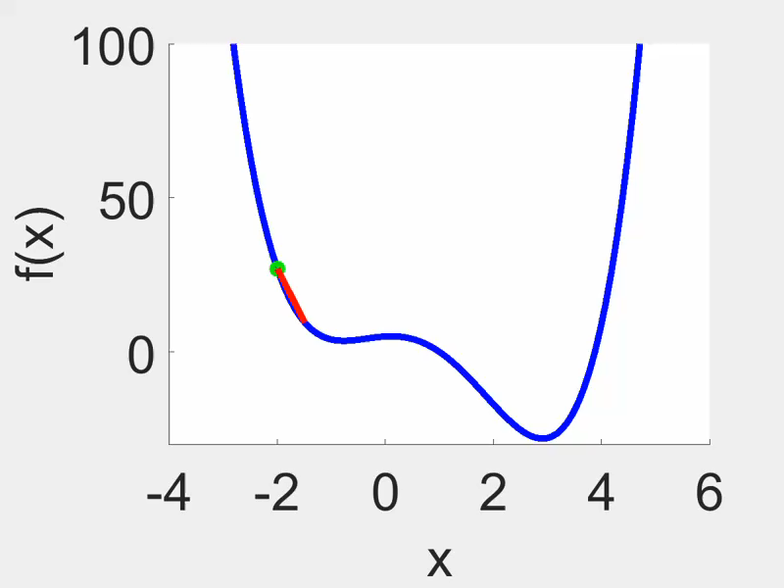
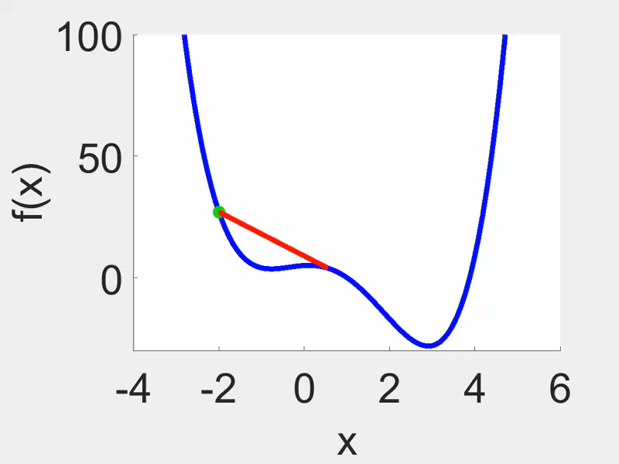
Squared Error Cost
$J\left(\overline{w},b\right)=\frac{1}{m}{\sum_{i=1}^{m}{{\frac{1}{2}(f}_{\overline{w},b}\left(x^{\left(i\right)}\right)−y^{\left(i\right)}) }}^{2}$
Convex
Non-Convex
Small learning rate
Non-Convex
Big learning rate
Linear regression
Logistic regression
Notes:
Squared error cost is a widely used cost function and works particularly well for some simple problems such as linear regression. Especially for such problems, squared error cost is a convex function that is easy to optimize. The most important property of convex functions is that all their local minima are also global minima. This means that there is only one best solution of the parameters to be optimized, so it is easy to find the correct values of the parameters to be optimized.
The cost function has the similar appearance; it is either convex or shaped like a bowl or hammer. Gradient descent will resemble this, where one step is followed by another and another until you reach the global minimum. You may now attempt to apply the same cost function to logistic regression. However, it turns out that if I plot the cost function using this value for f of x and put f of x = 1 over 1 plus e to the negative wx plus b, This turns into a non-convex cost function, which is not convex. It follows that if you attempted to apply gradient descent.
Let's say we have 2 classes, y output is 0 or 1 but x value is x1 and x2 and they are not linear.
Since our data will be nonconvex, it constitutes a case where we cannot calculate the error found by linear regression and squared error.
Non-convex cost functions can involve more complex structures and may have more than one local minimum. This means that the optimized parameters can get stuck in one of the local minima found, making it difficult to find the truly optimal solution.
Furthermore, the requirement that non-convex cost functions must be differentiable can be an obstacle in some cases, since the derivatives of these functions can often be very complex .For these reasons, non-convex cost functions are not suitable for complex problems that are difficult to optimize and may yield unguaranteed results. Different optimization techniques and cost functions may need to be used in such cases in order to find the parameters to be optimized in a more reliable and efficient way.
On the right side you can see 2 different examples. With small learning rate it gets stuck at the first local min while with big learning rate it jumps to the global min, but this is not a good way.

Slide 44
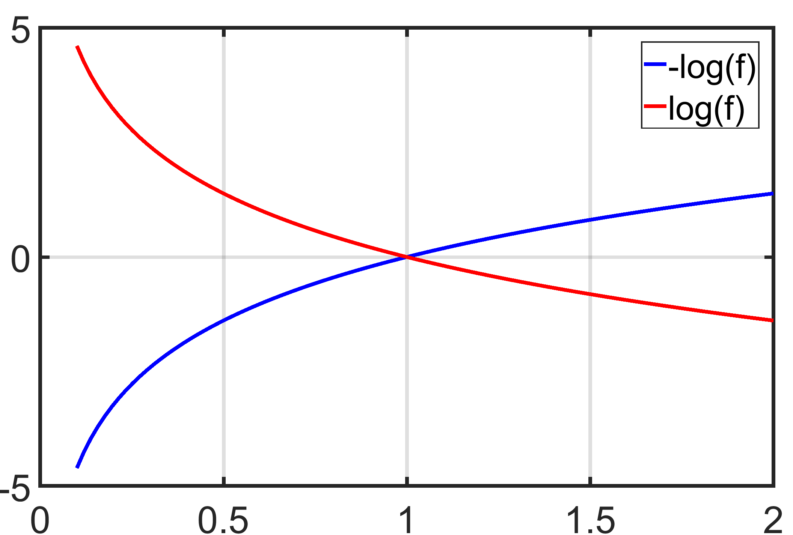
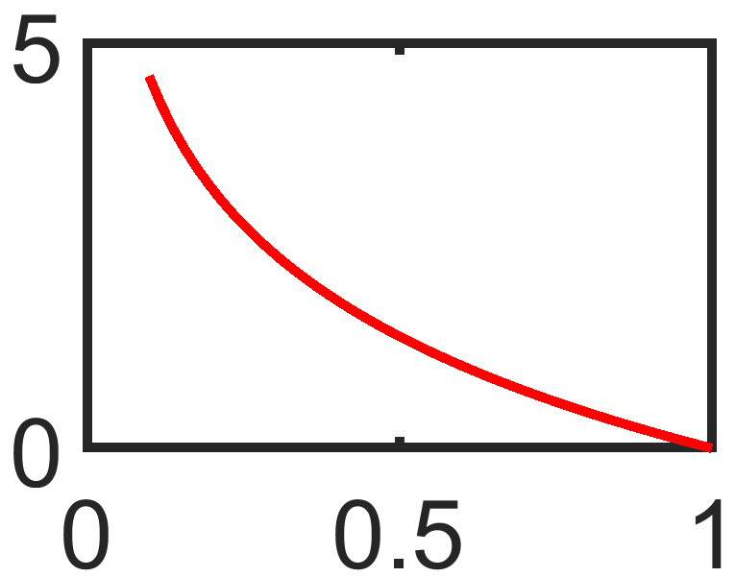


COST
$$J\left(\overline{w},b\right)=\frac{1}{m}\sum_{i=1}^{m}{L(f_{\overline{w},b}\left(x^{\left(i\right)}\right),y^{\left(i\right)})}$$
$$−log⁡(f_{\overline{w},b}\left(x^{\left(i\right)}\right) if y^{\left(i\right)}=1$$
$$L\left(f_{\overline{w},b}\left(x^{\left(i\right)}\right),y^{\left(i\right)}\right)=$$
$$−\log\left(1−f_{\overline{w},b}\left(x^{\left(i\right)}\right)\right) if y^{\left(i\right)}=0$$
y
f
Notes:
In this case, given the estimator f of x and the true label y, the loss is equal to half the squared difference. We'll see shortly that by choosing a different form for this loss function, will be able to keep the overall cost function, which is 1 over n times the sum of these loss functions to be a convex function. Now, the loss function inputs f of x and the true label y and tells us how well we're doing on that example.
Take a small remember the loss function measures how well you're doing on one training example and is by summing up the losses on all of the training examples that you then get, the cost function, which measures how well you're doing on the entire training set.
If we plot log(f) and see what it looks like, we get this graph, and if we plot -log(f) over it, we can see that these graphs intersect at a value of 1. The result of logistic regression is now f. As a result, since the result of logistic regression is always between zero and one, f is always between zero and one. Therefore, just this portion of the function, which corresponds to f between 0 and 1, is significant. If we look closely at this graph, we can see that as the x-axis, i.e. the function f, approaches 1, our cost approaches 0, which is very good for us. If the function f approaches 0, we can see that the cost can take infinite values, which is bad for us. Here in the definition of this loss function it seems that if we guess correctly the output cost is less and otherwise it is more.

Slide 45
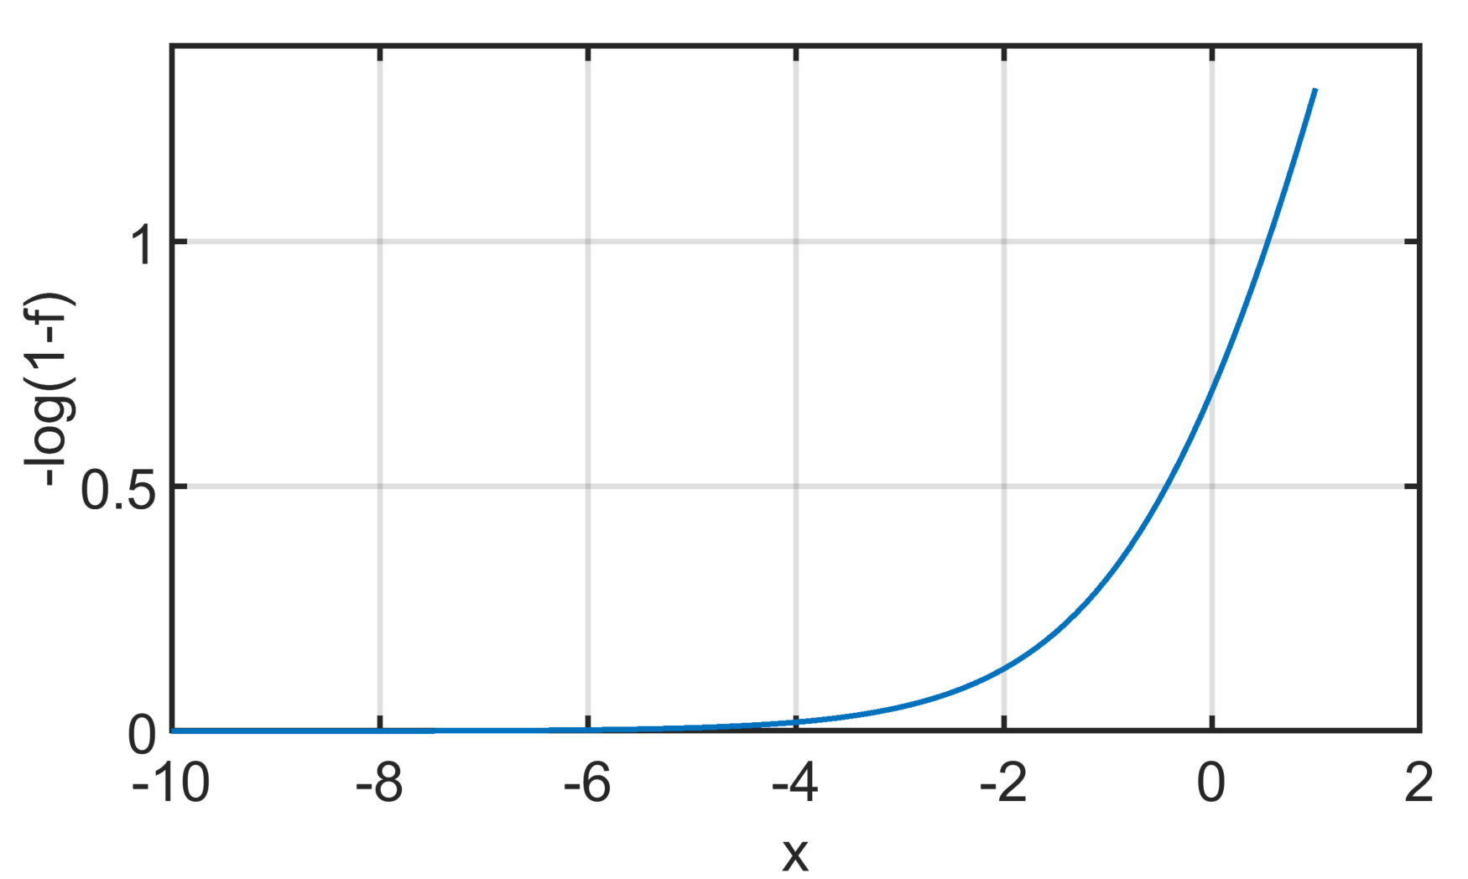


COST
$$J\left(\overline{w},b\right)=\frac{1}{m}\sum_{i=1}^{m}{L(f_{\overline{w},b}\left(x^{\left(i\right)}\right),y^{\left(i\right)})}$$
$$−log⁡(f_{\overline{w},b}\left(x^{\left(i\right)}\right) if y^{\left(i\right)}=1$$
$$L\left(f_{\overline{w},b}\left(x^{\left(i\right)}\right),y^{\left(i\right)}\right)=$$
$$−\log\left(1−f_{\overline{w},b}\left(x^{\left(i\right)}\right)\right) if y^{\left(i\right)}=0$$
Notes:
If we look at part 2, when f is zero or very close to zero, the loss will be extremely small. So if the true label is zero and the model's prediction is almost zero, the loss will be almost zero. As the prediction moves further and further away from the true label of 0, the loss increases as the value of f increases. The false label also imposes a high penalty. So we can see why The squared error cost function does not work well for logistic regression.

Slide 46

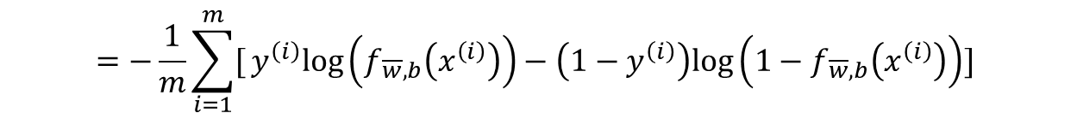
SIMPLIFIED COST FUNCTION
$$L\left(f_{\overline{w},b}\left(x^{\left(i\right)}\right),y^{\left(i\right)}\right)=−y^{\left(i\right)}log\left(f_{\overline{w},b}\left(x^{\left(i\right)}\right)\right)−\left(1−y^{\left(i\right)}\right)log\left(1−f_{\overline{w},b}\left(x^{\left(i\right)}\right)\right)$$
$$J\left(\overline{w},b\right)=\frac{1}{m}\sum_{i=1}^{m}{L(f_{\overline{w},b}\left(x^{\left(i\right)}\right),y^{\left(i\right)})}$$
$$=−{\frac{1}{m}\sum_{i=1}^{m}{[}y}^{\left(i\right)}log\left(f_{\overline{w},b}\left(x^{\left(i\right)}\right)\right)−\left(1−y^{\left(i\right)}\right)log\left(1−f_{\overline{w},b}\left(x^{\left(i\right)}\right)\right)]$$
Notes:
we'll see a slightly simpler way to write out the loss and cost functions, so that the implementation can be a bit simpler when we get to gradient descent for fitting the parameters of a logistic regression model.
In the previous slide we put the simplified loss function and this loss function is the generilized version for both 1 and 0 classes in total. If we replace y by 1, we can see that the terms on the right become 0 and only the term on the left remains. If we substitute 0, we get only the terms on the right while the terms on the left are completely 0. Our cost function can be obtained by dividing the sum of all losses up to m by the value of m. In the last version of the cost function, we can see the generilized loss function in - brackets.
açıklama
The last equatiın is similar to the negative log-likelihood function, which is commonly used in maximum likelihood estimation (MLE) in the context of logistic regression
I want to explain what is maximumlikelihood briefly. Maximum likelihood estimation is a general approach to estimating parameters in a statistical model by maximizing the likelihood function defined as:
let say L(θ∣X)=f(X∣θ)
that is, the probability of obtaining data X given some value of parameter θ. Knowing the likelihood function for a given problem you can look for such θ that maximizes the probability of obtaining the data you have. Sometimes we have known estimators, e.g. arithmetic mean is an MLE estimator for μ parameter for normal distribution, but in other cases, you can use different methods that include using optimization algorithms. ML approach does not tell you how to find the optimal value of θ, it just tells you how you can compare if one value of θ is "more likely" than the other.
Gradient descent is an optimization algorithm. You can use this algorithm to find minimum (or maximum, then it is called gradient ascent) of many different functions. The algorithm does not care what is the function that it minimizes, it just does what it was asked for. So with using an optimization algorithm you have to know somehow how could you tell if one value of the parameter of interest is "better" than the other. You have to provide your algorithm some function to minimize and the algorithm will deal with finding its minimum.
You can obtain maximum likelihood estimates using different methods and using an optimization algorithm is one of them. On another hand, gradient descent can be also used to maximize functions other than the likelihood function.

Slide 47
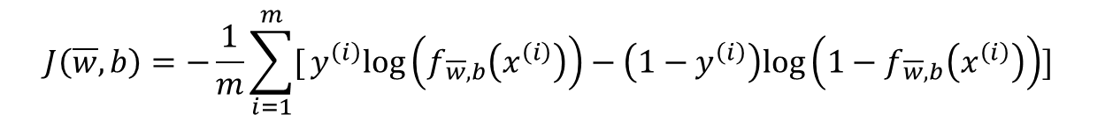
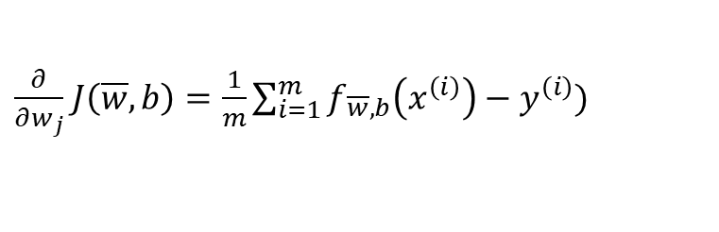
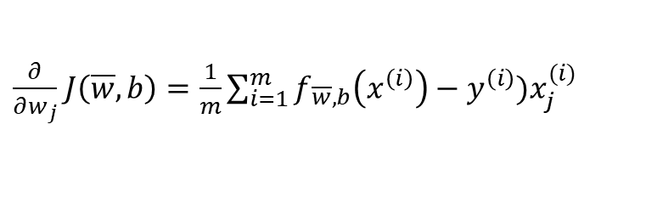


Gradient Descent Implementation
$$J\left(\overline{w},b\right)=−{\frac{1}{m}\sum_{i=1}^{m}{[}y}^{\left(i\right)}log\left(f_{\overline{w},b}\left(x^{\left(i\right)}\right)\right)−\left(1−y^{\left(i\right)}\right)log\left(1−f_{\overline{w},b}\left(x^{\left(i\right)}\right)\right)]$$
$w_{j}=w_{j} −∝\frac{∂}{∂w_{j}}$ $J\left(\overline{w},b\right)$
$\frac{∂}{∂w_{j}}$ $J\left(\overline{w},b\right)=\frac{1}{m}\sum_{i=1}^{m}{f_{\overline{w},b}\left(x^{\left(i\right)}\right)−y^{\left(i\right)})x_{j}^{(i)}}$
$b=b−∝\frac{∂}{∂w_{j}}$ $J\left(\overline{w},b\right)$
$\frac{∂}{∂w_{j}}$ $J\left(\overline{w},b\right)=\frac{1}{m}\sum_{i=1}^{m}{f_{\overline{w},b}\left(x^{\left(i\right)}\right)−y^{\left(i\right)}) }$
Notes:
If you want to minimize the cost j as a function of w and b, well, here's the usual gradient descent algorithm, where you repeatedly update each parameter as the 0 value minus Alpha, the learning rate times this derivative term. Let's take a look at the derivative of j with respect to w_j. This term up on top here, j goes from one through n, where n is the number of features. If someone were to apply the rules of calculus, you can show that the derivative with respect to w_j of the cost function capital J is equal to this expression over here, is 1 over m times the sum from 1 through m of this error term.
Now let's also look at the derivative of j with respect to the parameter b. It's quite similar to the expression above, except that it is not multiplied by this x superscript i subscript j at the end.

Slide 48
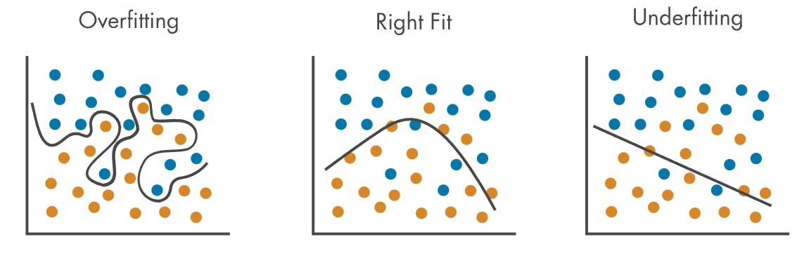


FITTING PROBLEMS
$$θ_{0}+θ_{1}x$$
$$θ_{0}+θ_{1}x+θ_{2}x^{2}$$
$θ_{0}+θ_{1}x+θ_{2}x^{2}+$ $θ_{2}x^{3}+θ_{2}x^{4}+…$
Error | Overfitting | Right Fit | Underfitting
Training | Low | Low | High
Test | High | Low | High
To reduce the impact of this tradeoff we use the concept of Regularization
Notes:
We have 3 type fitting problem. Lets talk about overfitting. When its occur? the model is so closely aligned to the training data that it does not know how to respond to new data. Why it is occur?
The machine learning model is too complex; it memorizes very detail patterns in the training data. It wont generalize well.
The training data size is too small for the model complexity and/or contains large amounts of irrelevant information.
Underfitting is the opposite concept of overfitting; the model doesn’t align well with the training data or generalize well to new data.
When we look the table, The errors are shown in test and train, overfitting, right fit and underfit. In overfitting, the error in train is low because it has memorized the data, so it gives good results, but when we put the data in the test, this memorization will give bad results because it is a different data pattern. In underfitting, the data will give bad results for both cases because it has not learned anything. In this case, the model may need more data. In right fit, test and train will give low error as we want.
What can we do prevent the overfitting?
To prevent overfitting, perform model validation to ensure that you choose a model with the right level of complexity for your data or use regularization to reduce the complexity of the model.

Slide 49
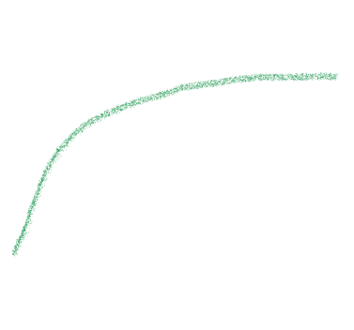

Regularization
Before regularization
After regularization
After collect more data
Notes:
Let’s now talk about regularization, which is a powerful method to reduce overfitting in machine learning models.
🔺 Top-left plot shows a model that’s overfitting. The red stars are our training data, and the blue curve is the fitted model. As you can see, it’s zigzagging to match every single point — this might look good on training data, but it will perform poorly on unseen data.
🔹 That’s where regularization comes in. On the top-right, after applying regularization, we get a much smoother line. It doesn’t try to fit every training point exactly — instead, it finds a simpler function that still captures the overall trend. This helps generalize better to new data.
🟦 Now look at the bottom-left. Here, instead of applying regularization, we try another approach: we collect more data. With more training examples (blue stars), the model naturally becomes more stable, and we reduce overfitting by increasing the size and diversity of our dataset.
✅ Finally, on the bottom-right, we see a nice result — after adding more data, the model fits both the old red data and the new blue data smoothly. This curve is simpler and much more reliable.

Slide 50
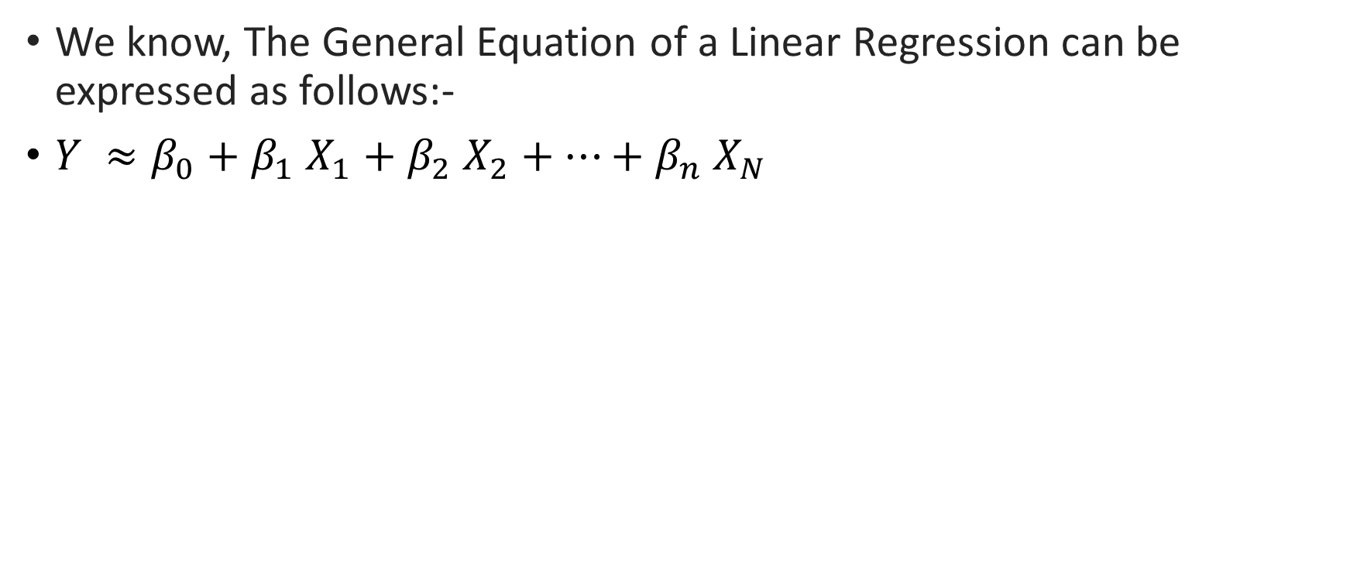

Regularization
We know, The General Equation of a Linear Regression can be expressed as follows:-
$Y ≈β_{0}+β_{1}$ $X_{1}+$ $β_{2}$ $X_{2}+…+β_{n}$ $X_{N}$
$$RSS=\sum_{i=1}^{m}{(y_{i} −β_{0}− {\sum_{j=1}^{m}{β_{j} X_{ij}) }}^{2}}$$
Notes:
Let’s start by remembering the general form of a Linear Regression model.
🔹 The model equation is:
Y ≈ β₀ + β₁X₁ + β₂X₂ + … + βₙXₙ
So, we’re trying to predict Y using a weighted combination of all input features, with weights β₁ to βₙ, plus an intercept β₀.
🔸 When we train this model, our goal is to find the best β values that minimize the error between the predicted output and the actual output.
That brings us to this cost function at the bottom:
RSS – the Residual Sum of Squares.
📉 This means:
RSS = Σ (yᵢ - β₀ - Σ βⱼxᵢⱼ)²
Here, for each data point, we subtract the predicted value from the true value, square the difference, and sum everything up across all data points.
✅ So the lower this RSS, the better our model fits the training data.
But here's the catch — if we have too many features or too flexible a model, we might fit the training data too perfectly. That leads to overfitting.
🔒 That’s where regularization comes in.
The idea is to add a penalty term to this cost function that discourages overly complex models.
📌 You might’ve heard of Ridge or Lasso regression — those are just regularized versions of linear regression. They modify this RSS by adding extra terms to penalize large β values. But don’t worry — we’re not diving into those specifically here.
Just remember:
➡️ Regularization helps us simplify the model, reduce overfitting, and generalize better to new data.
And it builds right on top of this basic linear regression structure.

Slide 51
Evaluating classification
A confusion matrix compares the predicted classes with the actual classes.
Suppose a model is used to identify a defined agricultural stress event.
These are illustrative counts from 200 observations.
Four outcomes
True positive (TP): Correctly identifies a positive event.
False positive (FP): Flags an event that was not positive.
False negative (FN): Fails to identify an actual positive event.
True negative (TN): Correctly identifies a negative event.
In this example, the model correctly identifies 40 positive observations and misses 10.
 | Actual positive | Actual negative
Predicted positive | TP = 40 | FP = 15
Predicted negative | FN = 10 | TN = 135

Slide 52
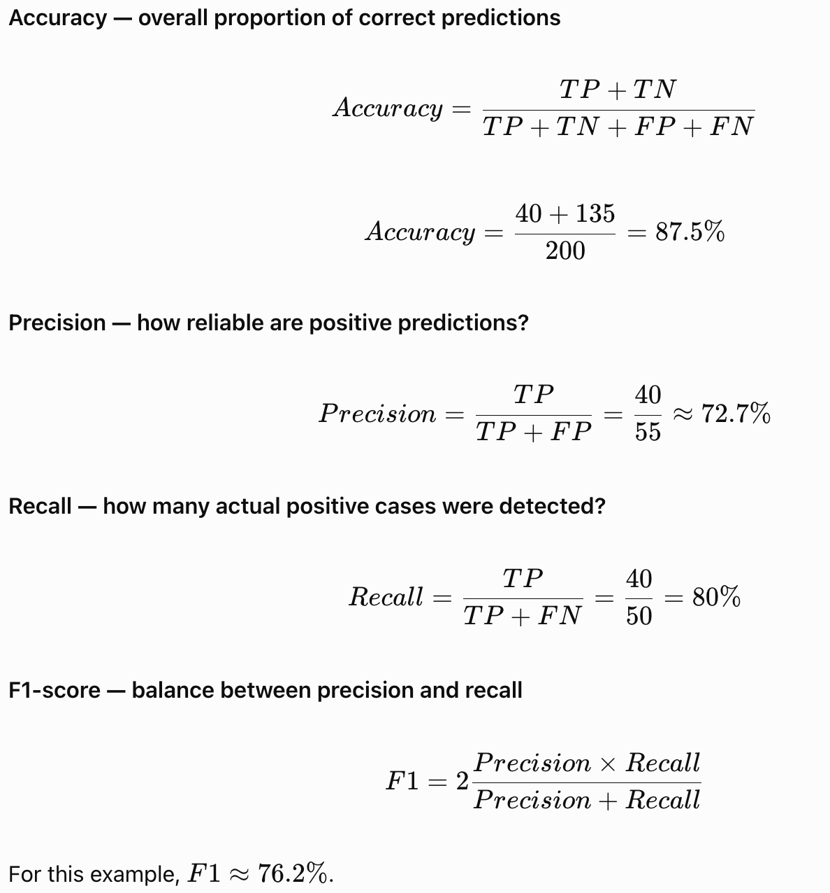
Accuracy, precision, recall and F1-score
Use the confusion matrix from the previous slide.
Interpretation
Accuracy answers: What proportion of all predictions were correct?
Precision answers: Of the predicted positive cases, what proportion were actually positive?
Recall answers: Of the actual positive cases, what proportion did the model identify?
F1-score balances precision and recall using their harmonic mean.

